Slide 1

CHAPTER 7
PROPERTIES OF FUNCTIONS
Copyright © Cengage Learning. All rights reserved.

Slide 2

7.3
Composition of Functions
Copyright © Cengage Learning. All rights reserved.

Slide 3

Composition of Functions
Consider two functions, the successor function and the squaring function, both defined from Z to Z, and imagine that each is represented by a machine.
If the two machines are hooked up so that the output from the successor function is used as input to the squaring function, then they work together to operate as one larger machine.
In this larger machine, an integer n is first increased by 1 to obtain n + 1; then the quantity n + 1 is squared to obtain

Slide 4
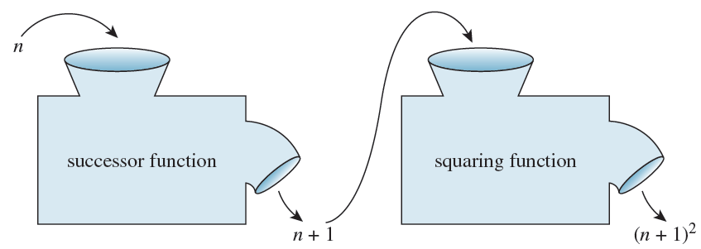
Composition of Functions
This is illustrated in the following drawing.

Slide 5
Composition of Functions
Combining functions in this way is called composing them; the resulting function is called the composition of the two functions.
Note that the composition can be formed only if the output of the first function is acceptable input to the second function. That is, the range of the first function must be contained in the domain of the second function.

Slide 6
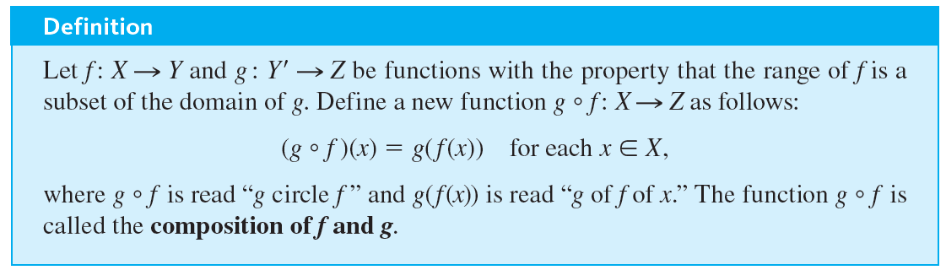
Composition of Functions

Slide 7
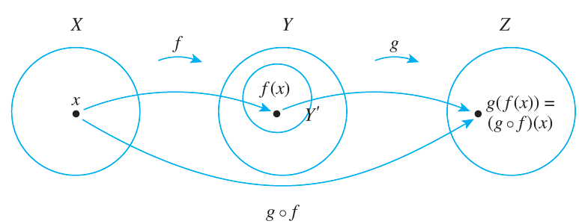
Composition of Functions
This definition is shown schematically below.

Slide 8



Example 7.3.1 – Composition of Functions Defined by Formulas
Let f : Z → Z be the successor function and let g : Z → Z be the squaring function. Then f (n) = n + 1 for each n ∈ Z and
for each n ∈ Z.
a. Find the compositions
b. Is

Slide 9
Example 7.3.1 – Solution
a. Because f sends each integer to that integer plus 1 and g sends each integer to the square of that integer, it can be helpful to think of the action of f and g as follows:
f (any integer) = that integer + 1 [even if the integer is g(n)].

Slide 10

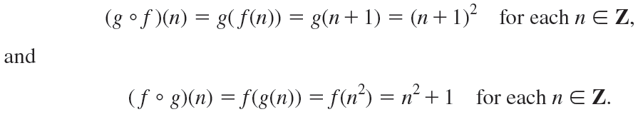
Example 7.3.1 – Solution
continued
Thus the functions
are defined as follows:
b. Two functions from one set to another are equal if, and only if, they always take the same values. In this case,

Slide 11


Example 7.3.1 – Solution
continued
Thus the two functions
are not equal:

Slide 12
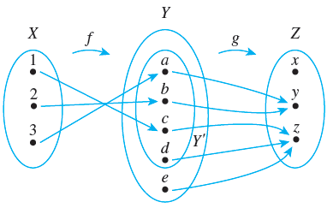


Example 7.3.2 – Composition of Functions Defined on Finite Sets
Let X = {1, 2, 3}, Y ′ = {a, b, c, d}, Y = {a, b, c, d, e}, and Z = {x, y, z}. Define functions f : X → Y ′ and g : Y → Z by the arrow diagrams below.
Draw the arrow diagram for
What is the range of

Slide 13

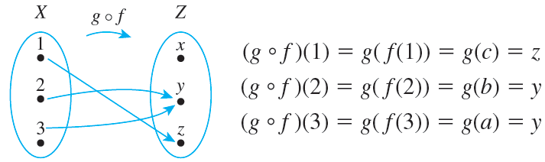

Example 7.3.2 – Solution
To find the arrow diagram for
just trace the arrows all the way across from X to Z through Y. The result is shown below.
The range of

Slide 14
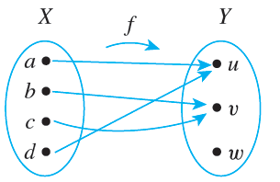

Example 7.3.3 – Composition with the Identity Function
Let X = {a, b, c, d} and Y = {u, v, w}, and suppose f : X → Y is given by the arrow diagram shown below.

Slide 15

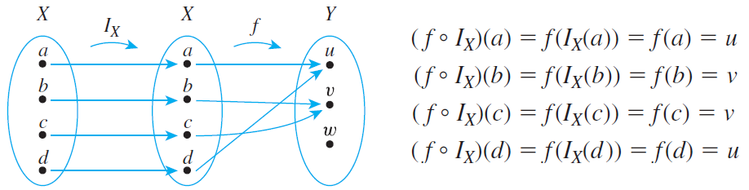

Example 7.3.3 – Solution
The values of
are obtained by tracing through the arrow diagram shown below.
Thus, for every element x in X,

Slide 16



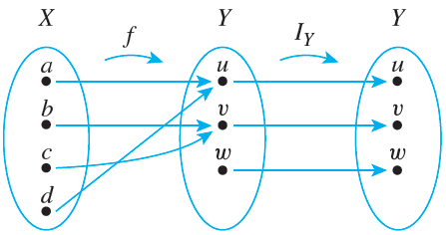
Example 7.3.3 – Solution
continued
By definition of equality of functions, this means that
Similarly, the equality
can be verified by tracing through the arrow diagram below for each x in X and noting that in each case,

Slide 17
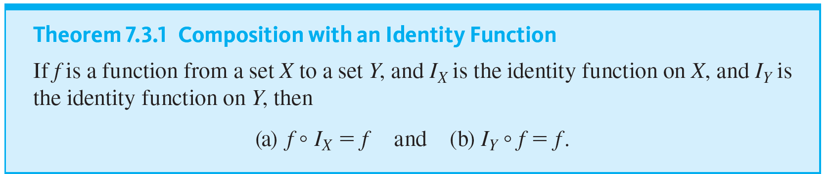
Composition of Functions

Slide 18
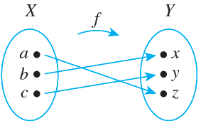
Example 7.3.4 – Composing a Function with Its Inverse
Let X = {a, b, c} and Y = {x, y, z}. Define f : X → Y by the following arrow diagram.
You can see from the diagram that f is one-to-one and onto.

Slide 19

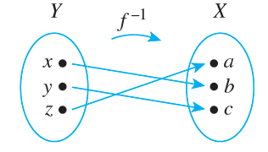

Example 7.3.4 – Composing a Function with Its Inverse
continued
Thus
exists and is found by tracing the arrows backwards, as shown below.
is found by following the arrows from X to Y by f and back to X by
Now
. If you do this, you will see that

Slide 20



Example 7.3.4 – Composing a Function with Its Inverse
continued
and
Thus the composition of f and
sends each element to itself. So by definition of the identity function,
In a similar way, you can see that

Slide 21
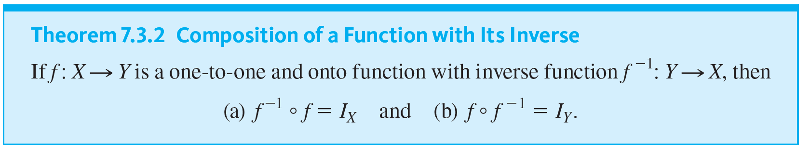
Composition of Functions

Slide 22
Composition of One-to-One Functions

Slide 23
Composition of One-to-One Functions
The composition of functions interacts in interesting ways with the properties of being one-to-one and onto.
What happens, for instance, when two one-to-one functions are composed?
Must their composition be one-to-one?

Slide 24
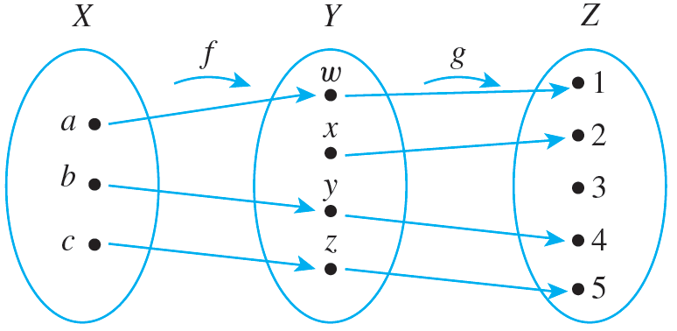
Composition of One-to-One Functions
For example, let X = {a, b, c}, Y = {w, x, y, z}, and Z = {1, 2, 3, 4, 5}, and define one-to-one functions f : X → Y and g : Y → Z as shown in the arrow diagrams of Figure 7.3.1.
Figure 7.3.1

Slide 25

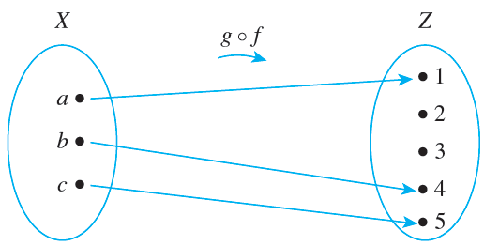
Composition of One-to-One Functions
Then
is the function with the arrow diagram shown in Figure 7.3.2.
Figure 7.3.2
From the diagram it is clear that for these particular functions, the composition is one-to-one.

Slide 26
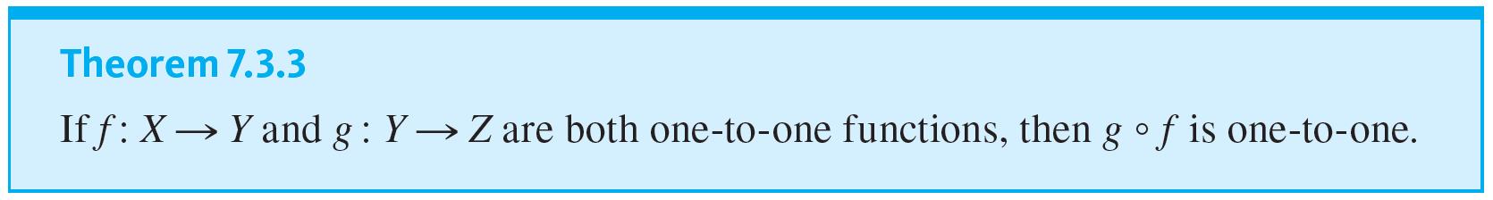
Composition of One-to-One Functions
This result is no accident. It turns out that the composition of two one-to-one functions is always one-to-one.

Slide 27
Composition of Onto Functions

Slide 28
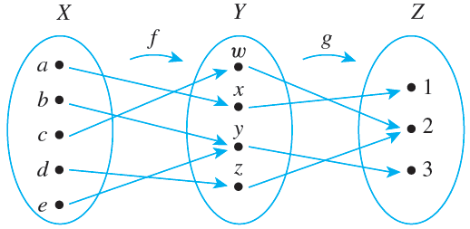
Composition of Onto Functions
Now consider what happens when two onto functions are composed. For example, let X = {a, b, c, d, e}, Y = {w, x, y, z}, and Z = {1, 2, 3}. Define onto functions f and g by the following arrow diagrams.

Slide 29
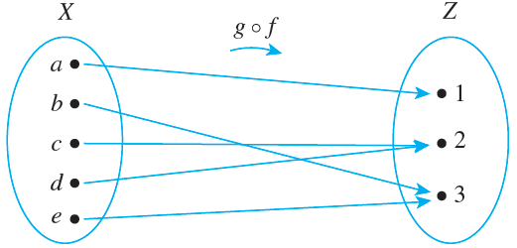
Composition of Onto Functions
Then
is the function with the arrow diagram shown below.
It is clear from the diagram that
is onto.

Slide 30
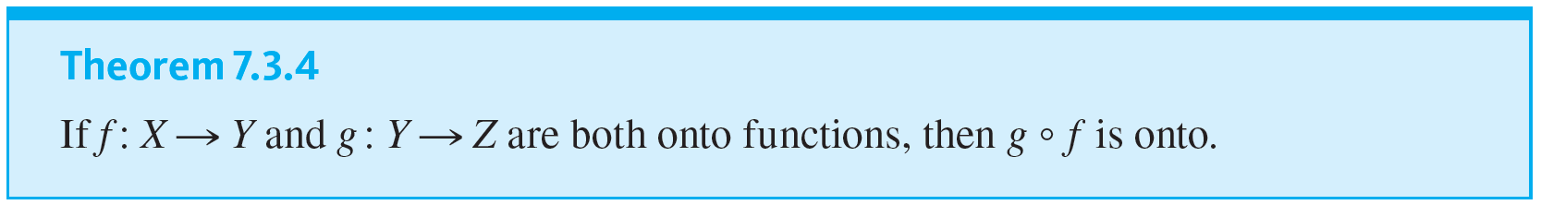
Composition of Onto Functions
It turns out that the composition of any two onto functions (that can be composed) is onto.

